Slide 1
Fast Fourier Transform
Advanced Methods for Scientific Computing
Course project
Giorgio Miani – Pietro Pasquini

Slide 2
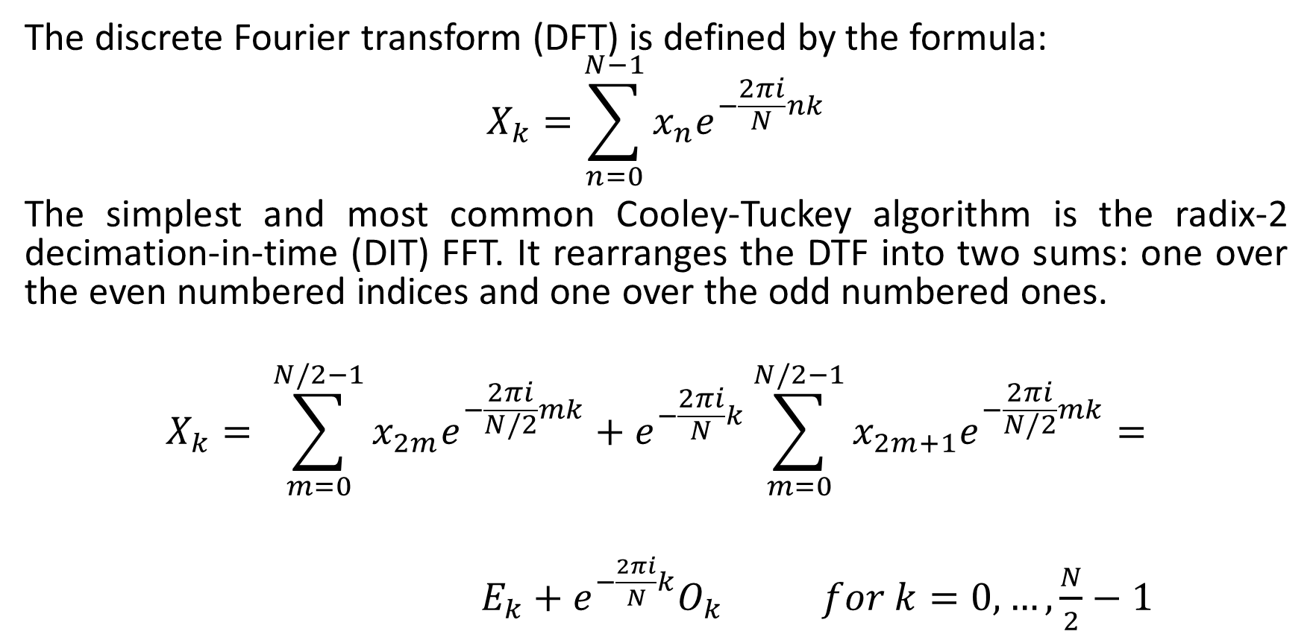
Cooley–Tukey FFT algorithm
The discrete Fourier transform (DFT) is defined by the formula:
$$X_{k}=\sum_{n=0}^{N−1}{x_{n}e^{−\frac{2πi}{N}nk}}$$
The simplest and most common Cooley-Tuckey algorithm is the radix-2 decimation-in-time (DIT) FFT. It rearranges the DTF into two sums: one over the even numbered indices and one over the odd numbered ones.
$$X_{k}= \sum_{m=0}^{N/2−1}{x_{2m}e^{−\frac{2πi}{N/2}mk}}+e^{−\frac{2πi}{N}k}\sum_{m=0}^{N/2−1}{x_{2m+1}e^{−\frac{2πi}{N/2}mk}}=$$
$E_{k}+$ $e^{−\frac{2πi}{N}k}O_{k} for k=0,…,\frac{N}{2}−1$

Slide 3
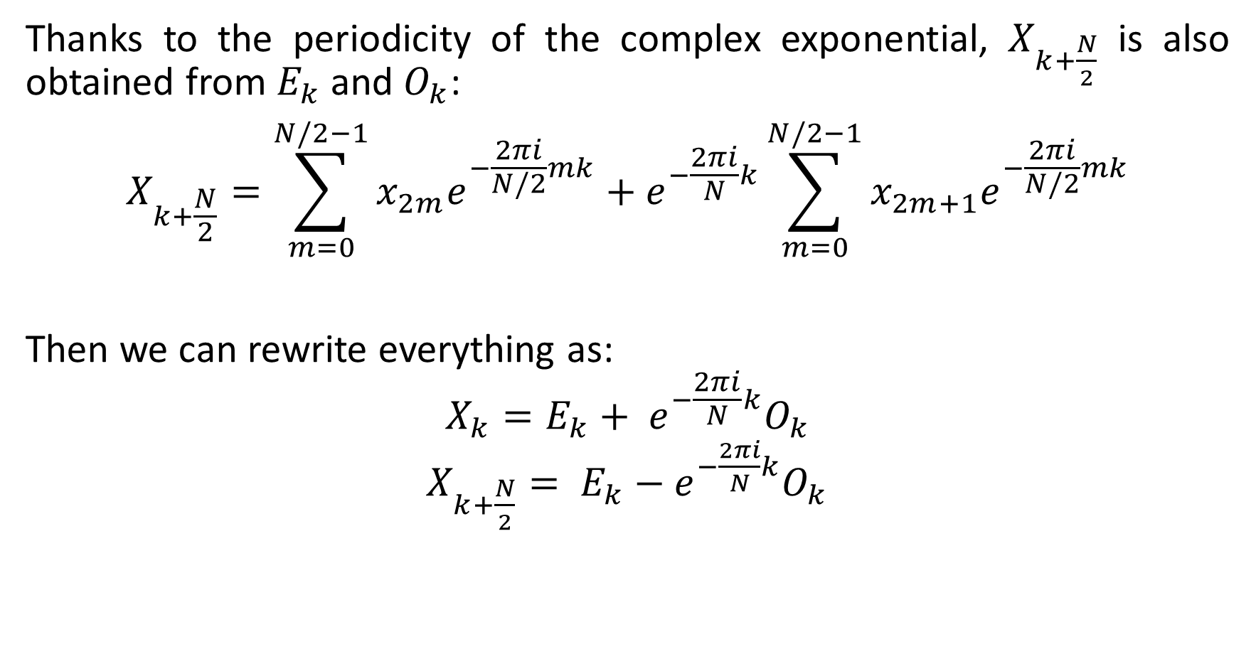
Thanks to the periodicity of the complex exponential, $X_{k+\frac{N}{2}}$ is also obtained from $E_{k}$ and $O_{k}$:
$$X_{k+\frac{N}{2}}=\sum_{m=0}^{N/2−1}{x_{2m}e^{−\frac{2πi}{N/2}mk}}+e^{−\frac{2πi}{N}k}\sum_{m=0}^{N/2−1}{x_{2m+1}e^{−\frac{2πi}{N/2}mk}}$$
Then we can rewrite everything as:
$$X_{k}=E_{k}+ e^{−\frac{2πi}{N}k}O_{k}$$
$X_{k+\frac{N}{2}}= E_{k}−$ $e^{−\frac{2πi}{N}k}O_{k}$

Slide 4
1D FFT

Slide 5
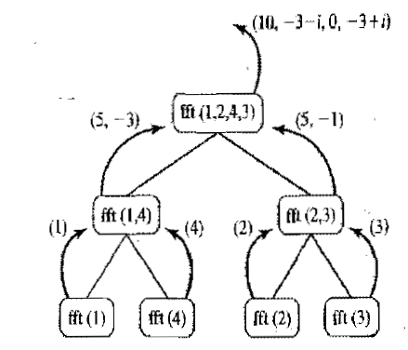
Recursive algorithm
We can implement the Cooley-Tuckey algorithm by writing a recursive function that exploits the symmetry we saw in the previous slide by dividing the inputs between those that have even and odd indexes at each step.

Slide 6
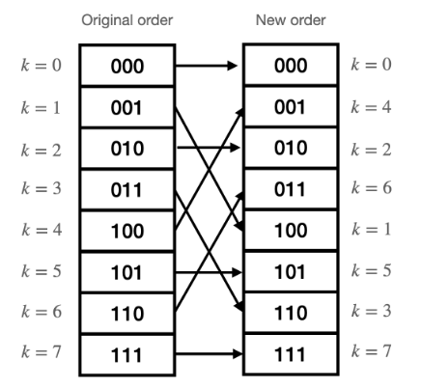
Iterative algorithm
Although it is the simplest solution, in general it is better to avoid recursive algorithms because they are less efficient and, in this case, more complex to parallelize.
We then write an algorithm that doesn’t need recursion.
First, we modify the order of the inputs using a bit reversal algorithm: by doing so, the first two elements of the new vector will be the result of the recursive selection of even inputs, the next two of the selection of even inputs at every step apart form the last, and so on.

Slide 7
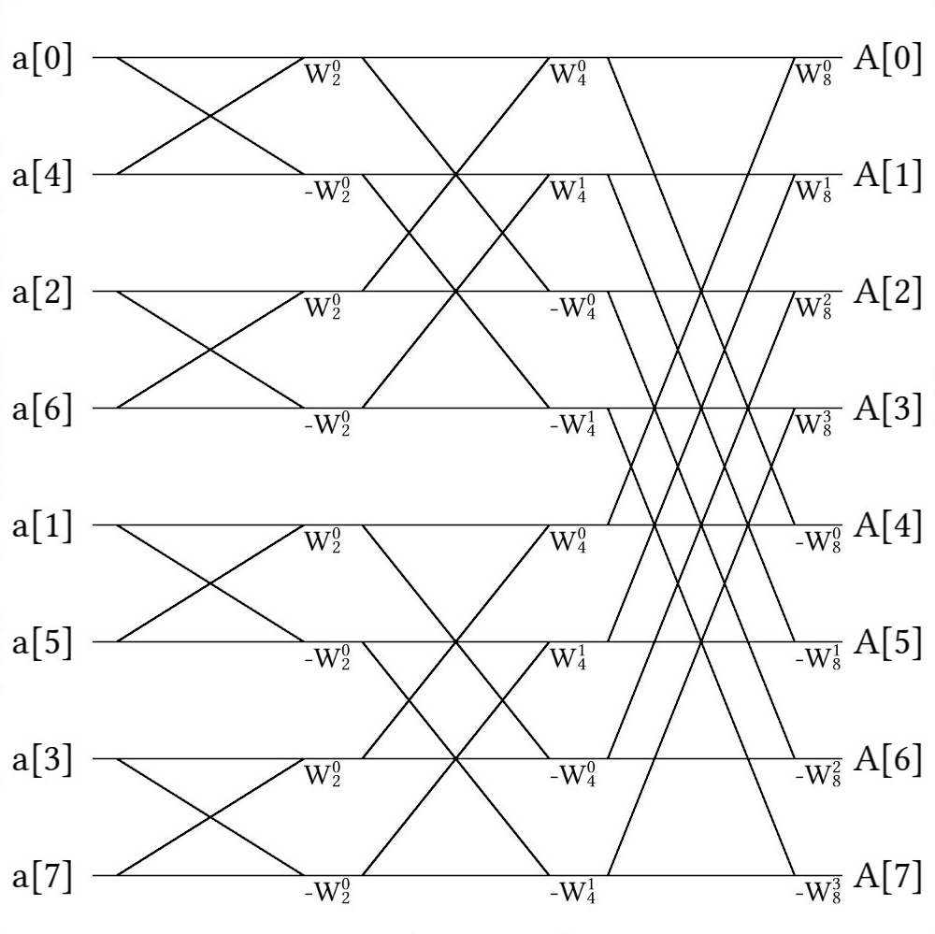
Then, after properly reordering the values, we can proceed by writing the same operations that the recursive algorithm would have done.

Slide 8
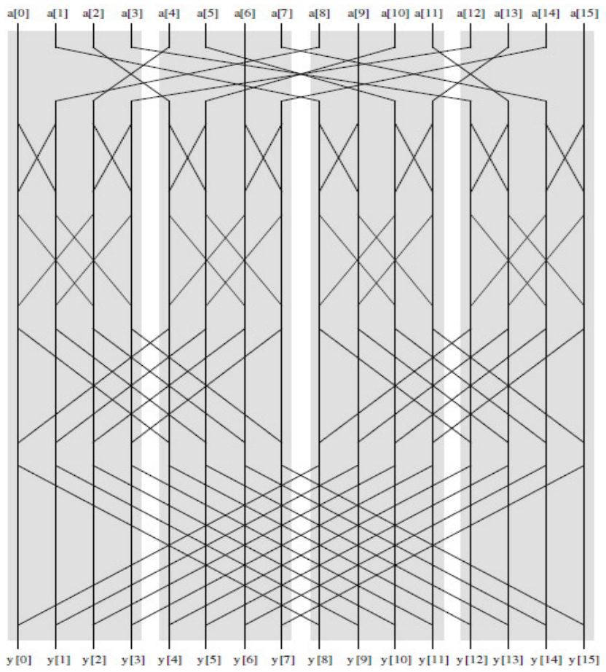
Parallel algorithm
The parallel algorithm can be divided into 3 phases.
PHASE 1
PHASE 2
PHASE 3

Slide 9
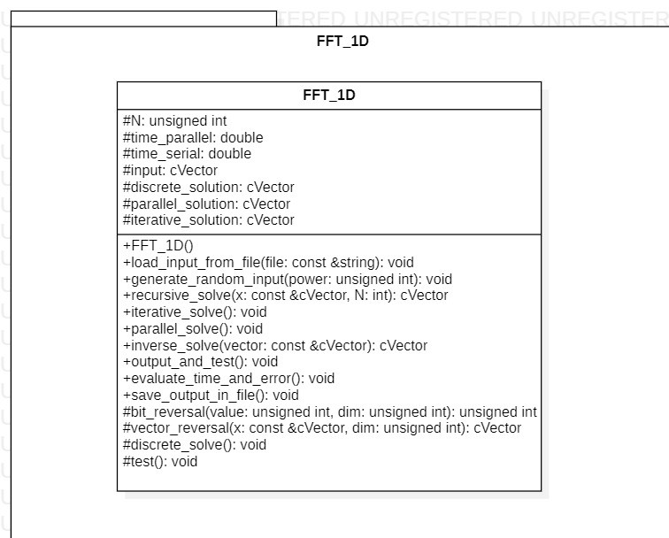
UML
Here is represented the UML diagram of the class, where:
cVector = std::vector<std::complex<double>>

Slide 10
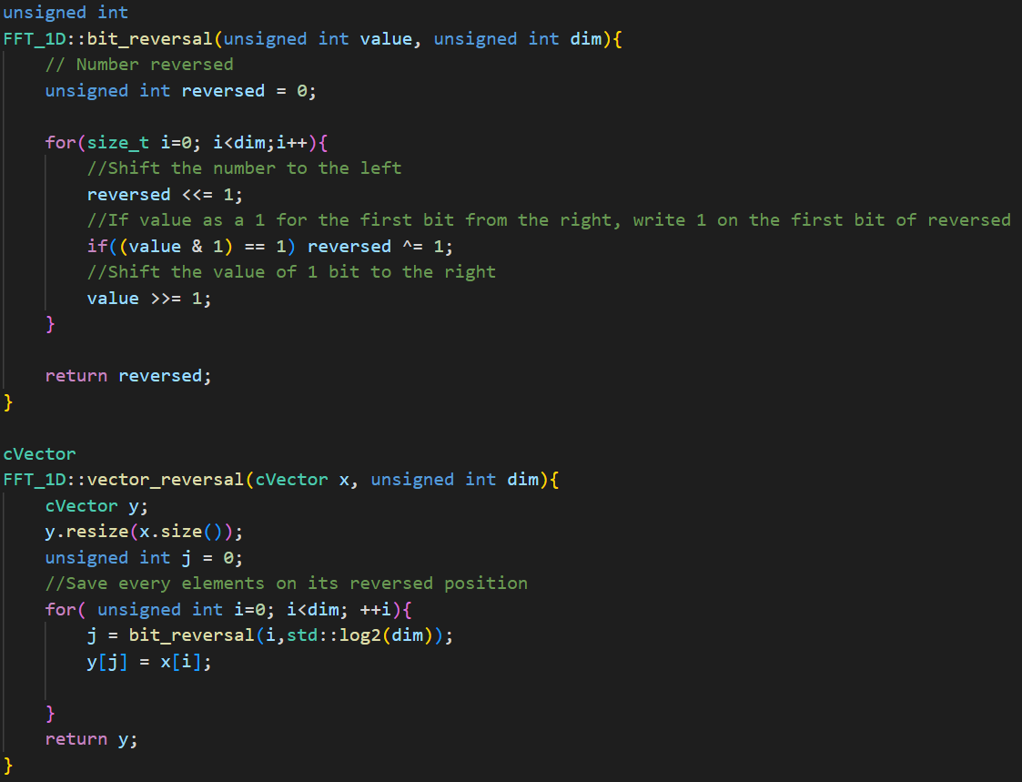
Phase 1
Phase 1 is the reordering phase using the bit reversal algorithm.

Slide 11
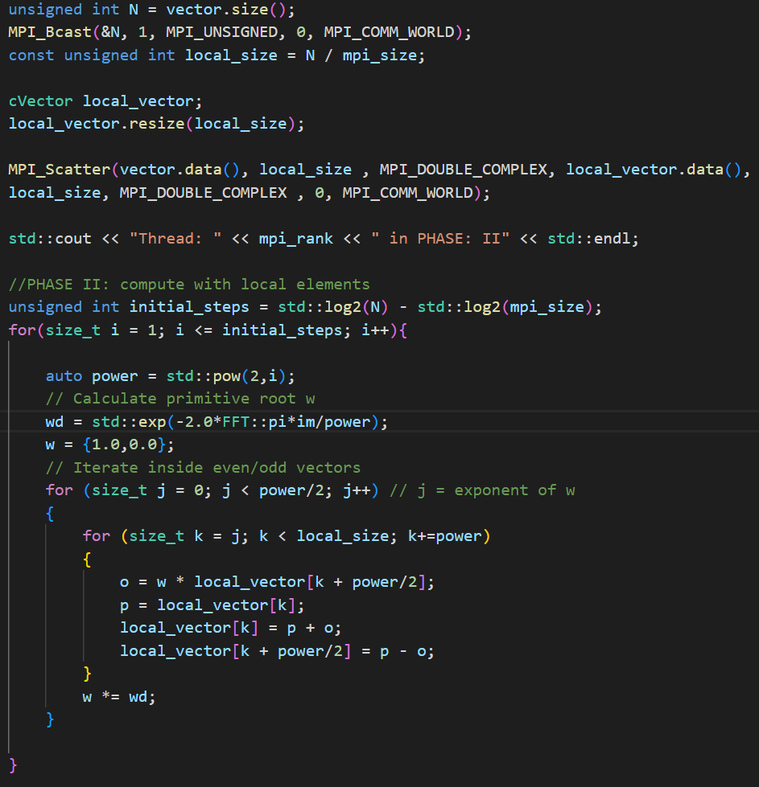
Phase 2
During phase 2 the threads can execute the iterative algorithm independently because all the necessary data has been scattered to its respective thread, so there is no need for communication.

Slide 12
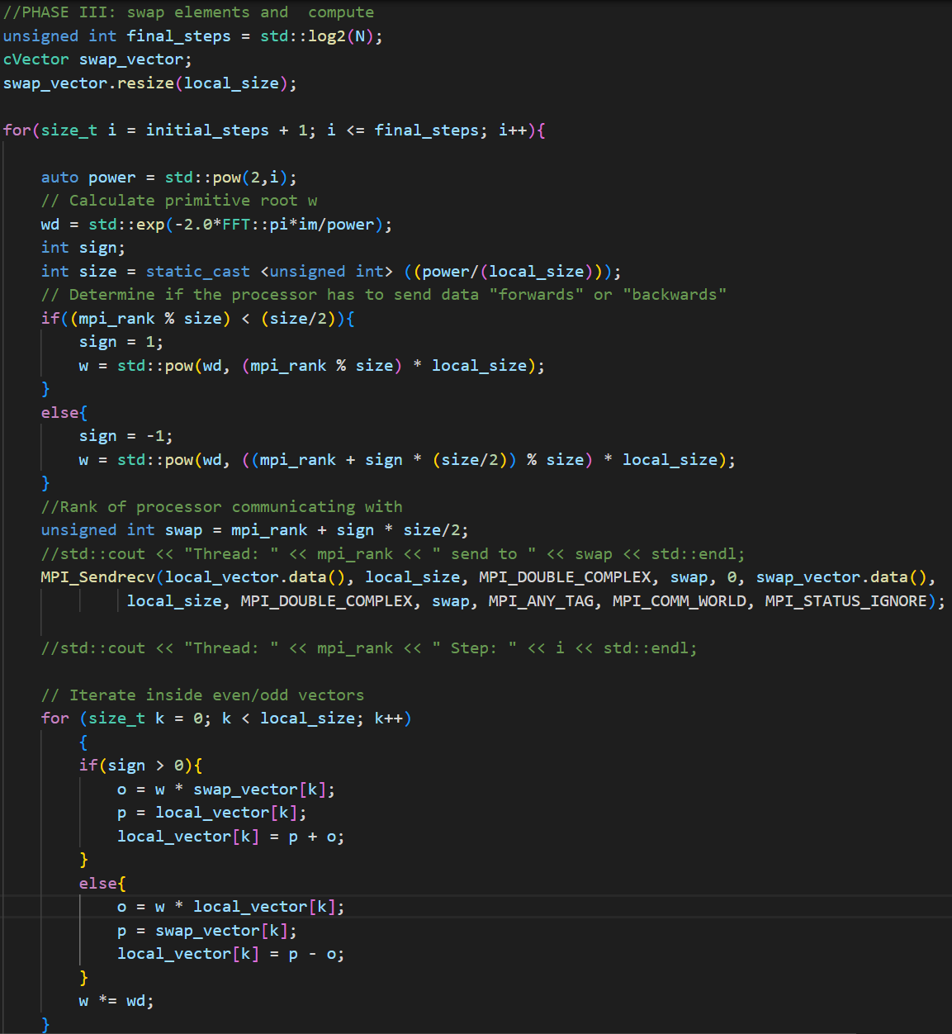
Phase 3
During phase 3 the threads have to communicate with each other, so we must modify the iterative algorithm to accommodate the communications.

Slide 13
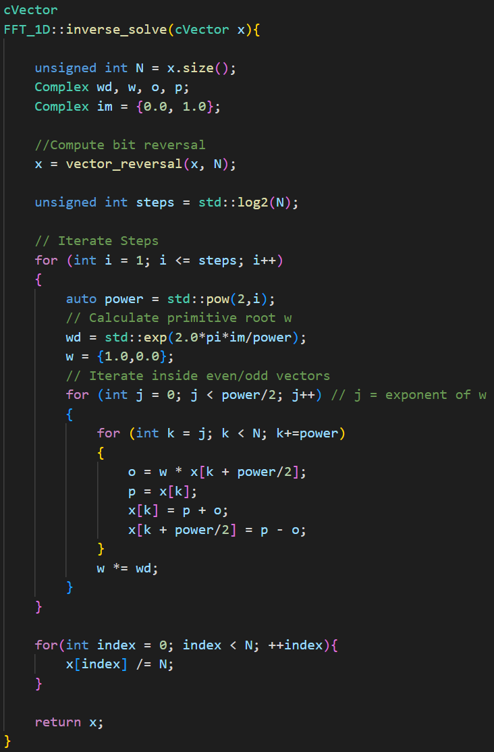
Inverse FFT

Slide 14
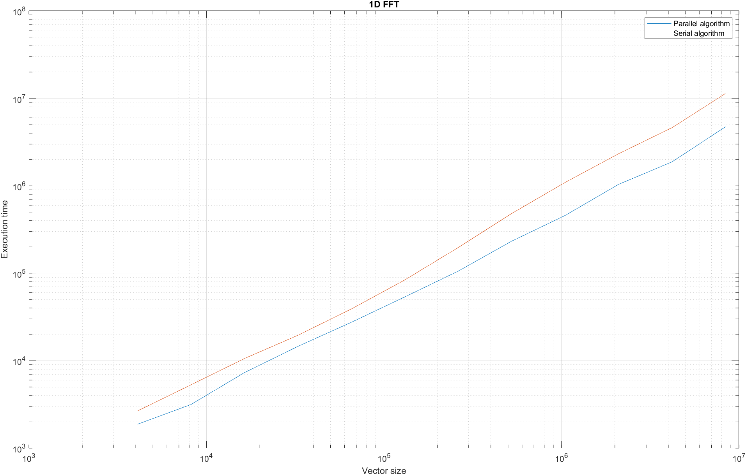
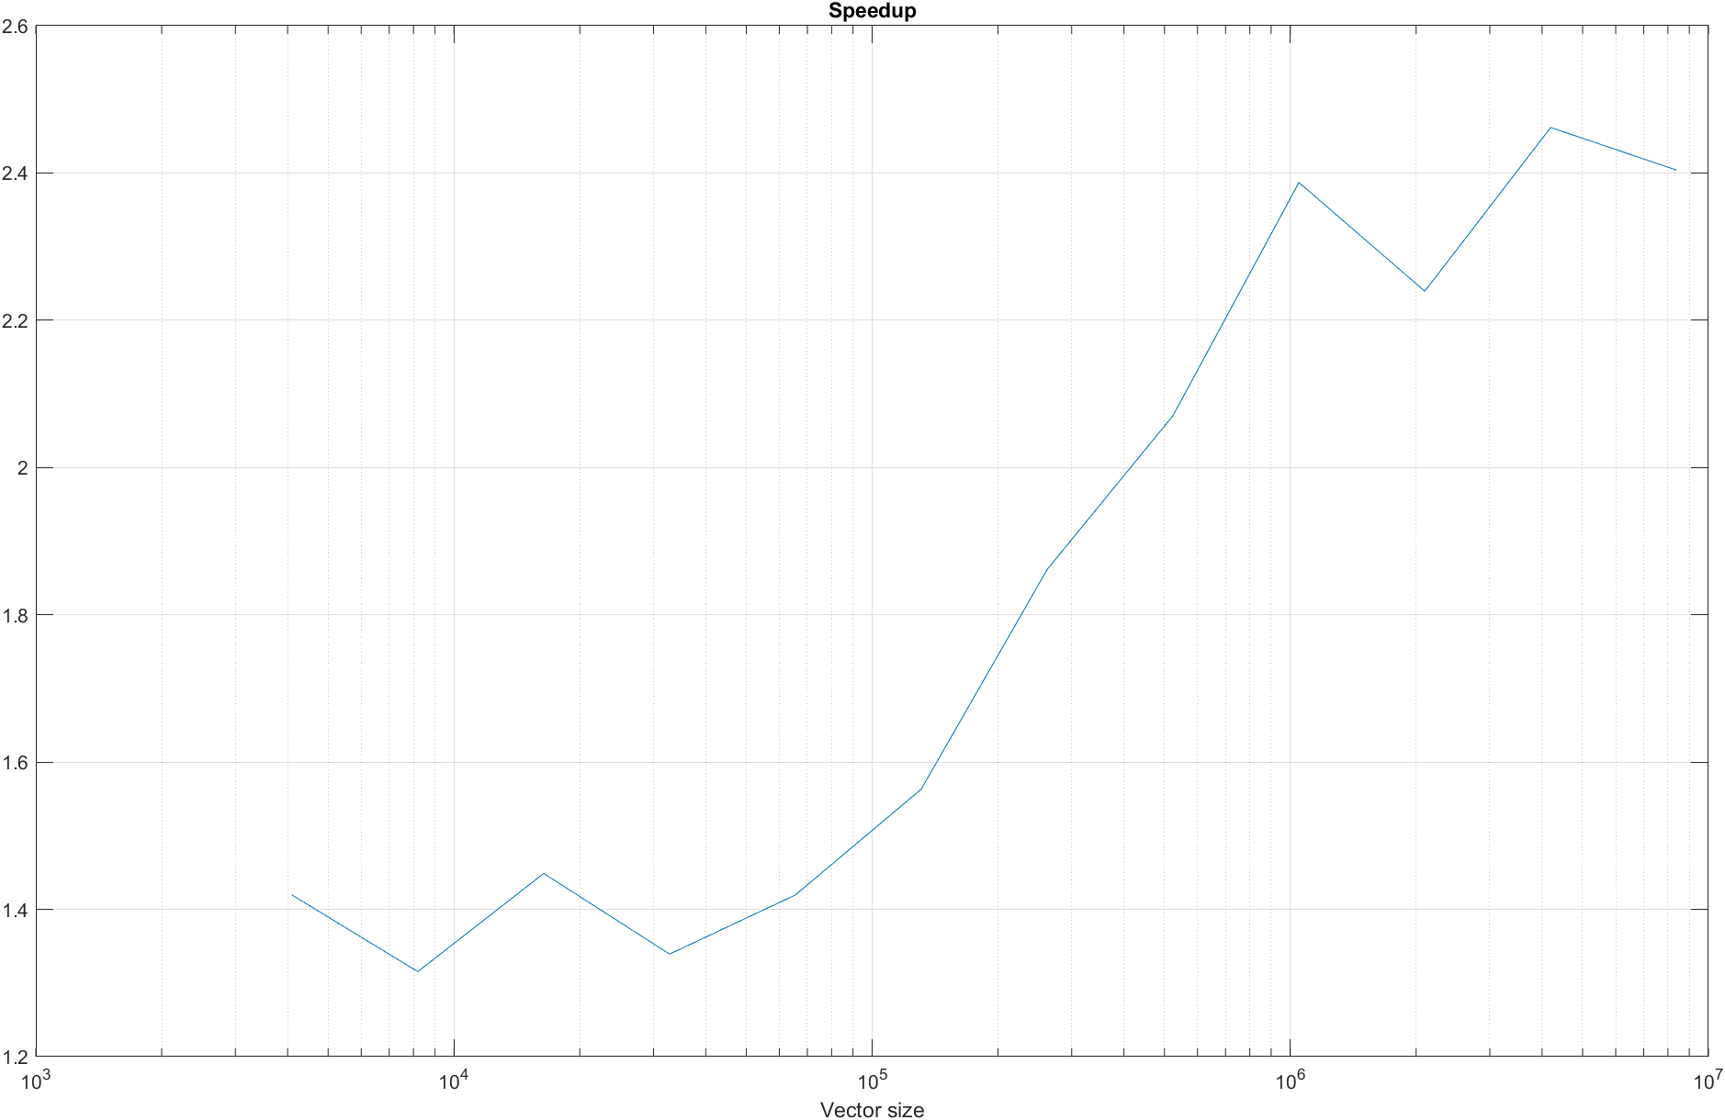
Time analysis

Slide 15
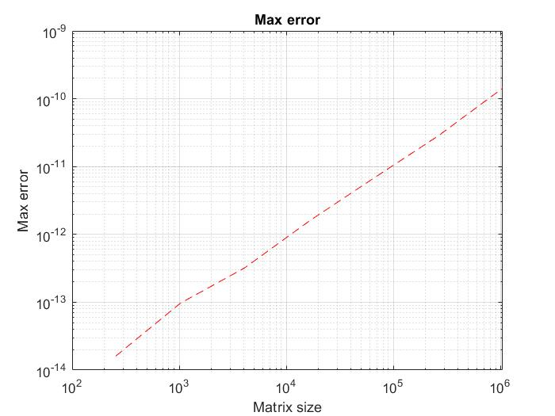
Error analysis

Slide 16
2D FFT and image compression

Slide 17
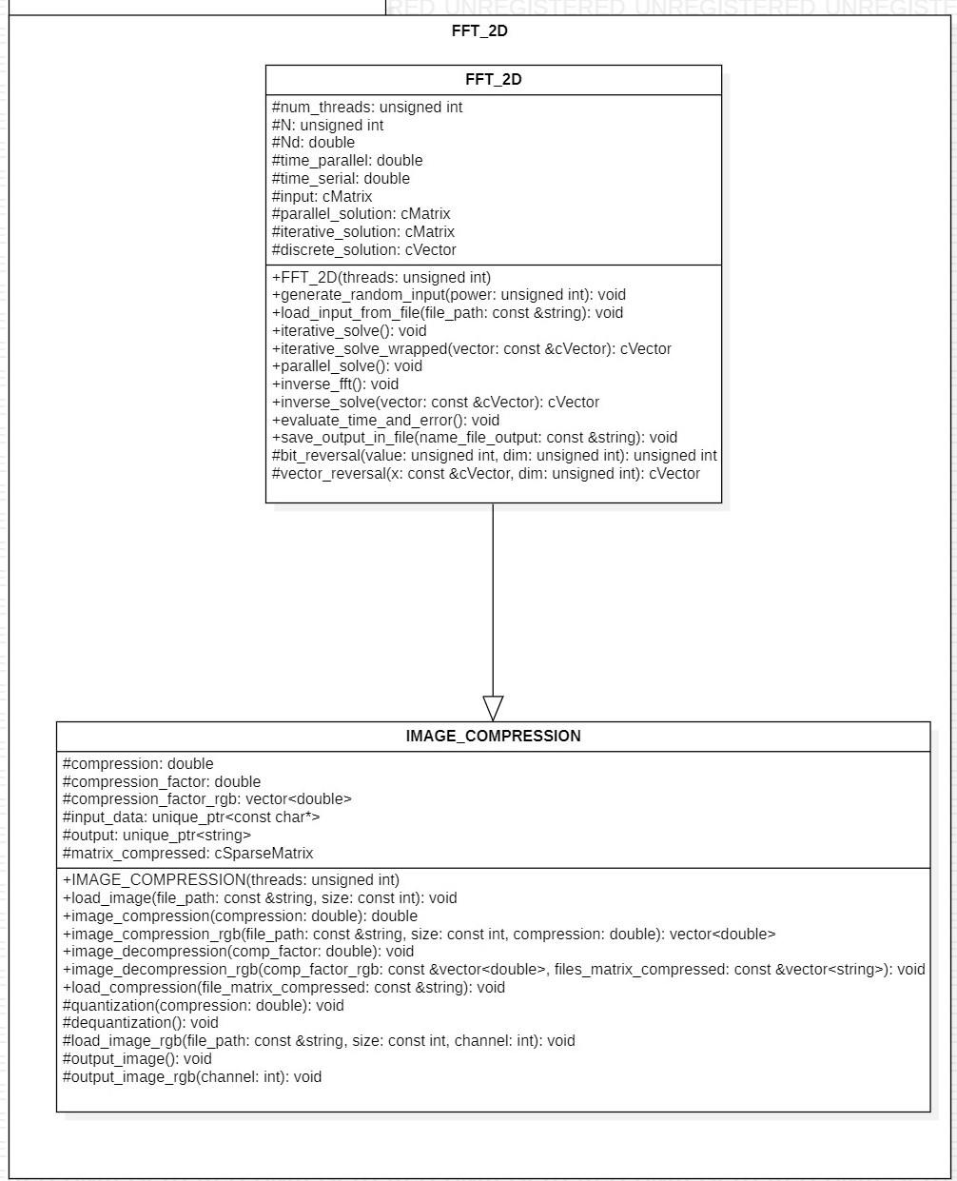
UML
Here is represented the UML diagram of the class, where:
cVector = Eigen::VectorXcd;
cMatrix = Eigen::MatrixXcd;
cSparseMatrix = Eigen::SparseMatrix<Complex>;

Slide 18
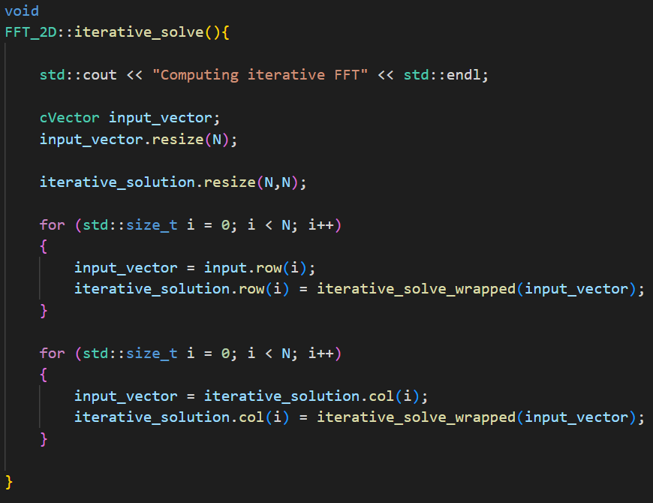
Iterative algorithm
For the 2D iterative FFT we simply performed the 1D FFT algorithm on each row and then on each column of the input matrix

Slide 19
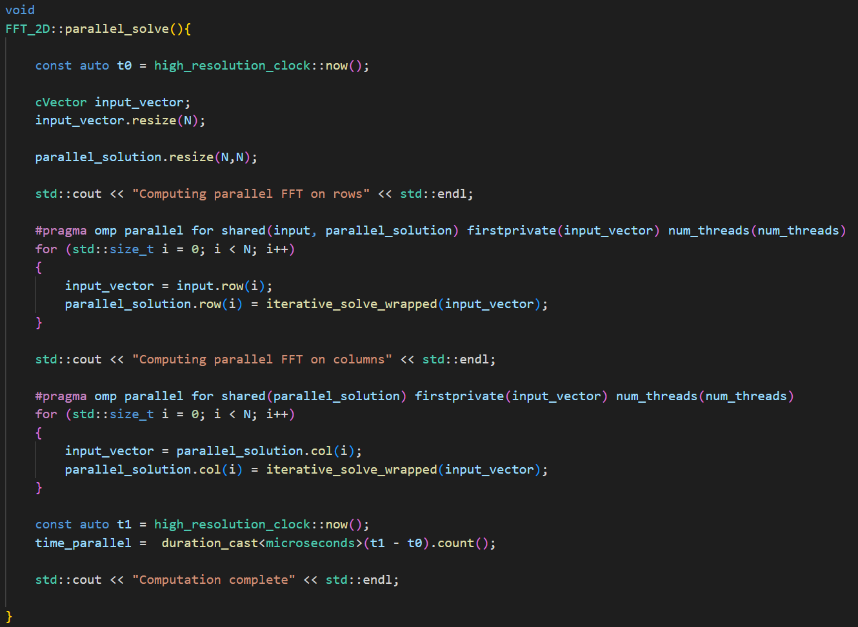
Parallel algorithm
For the parallel algorithm we parallelized the execution of the 1D iterative FFT algorithm on different rows and columns using OMP.
We didn’t utilize the parallel 1D algorithm because, given the relatively small size of the rows and columns, especially in images, this type of parallelization would not be efficient.

Slide 20


Image compression
The image compression algorithm that we implemented basically applies the Fourier transform to the image, divides all frequencies by the matrix’s mean value (multiplied by a compression parameter), discards the ones lower then 1 and saves the matrix compressed. During the decompression it finally performs the inverse process of the compression (using the inverse Fourier transform) in order to reobtain the image.
(Note that compression and decompression must not necessarily be perfomed on the same class! It is also possible to compress in a class and decompress on a different one just created! Mind only to save the compression factor(s))

Slide 21
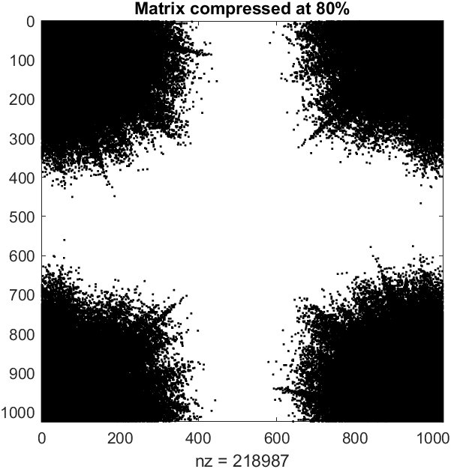
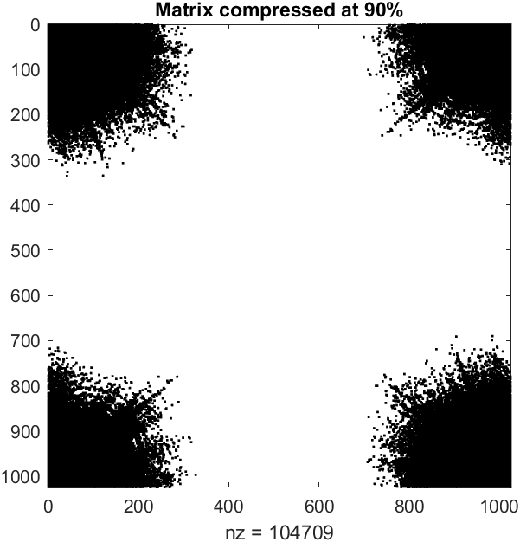
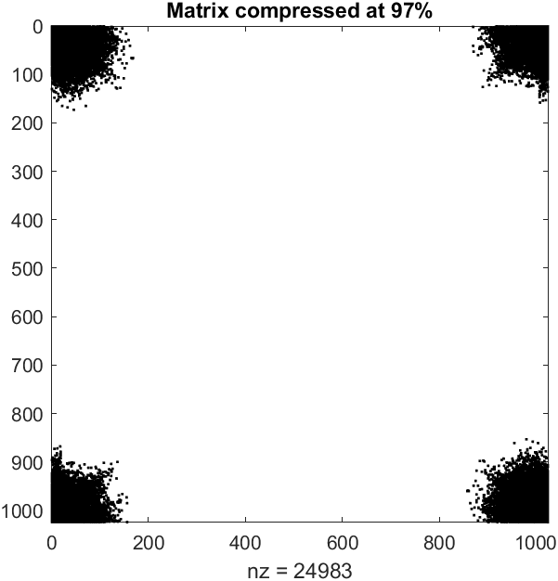

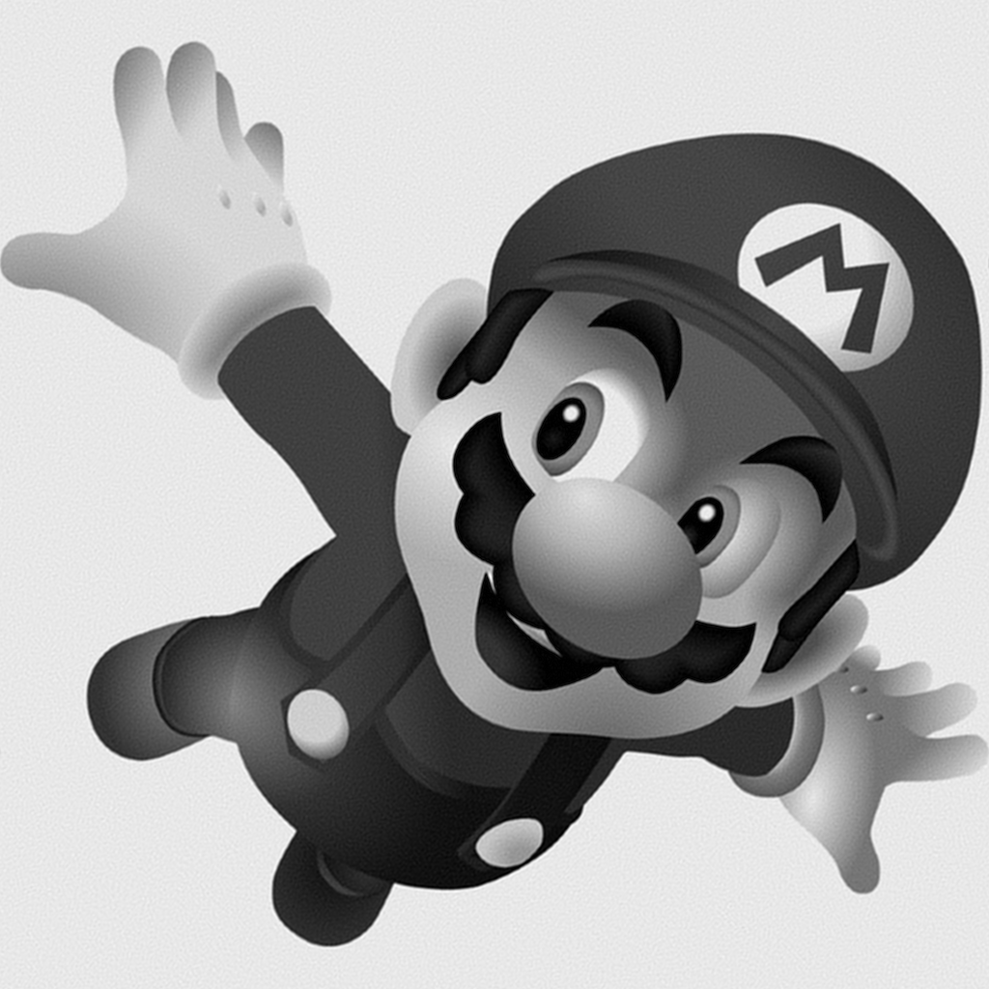

Compression rate examples

Slide 22
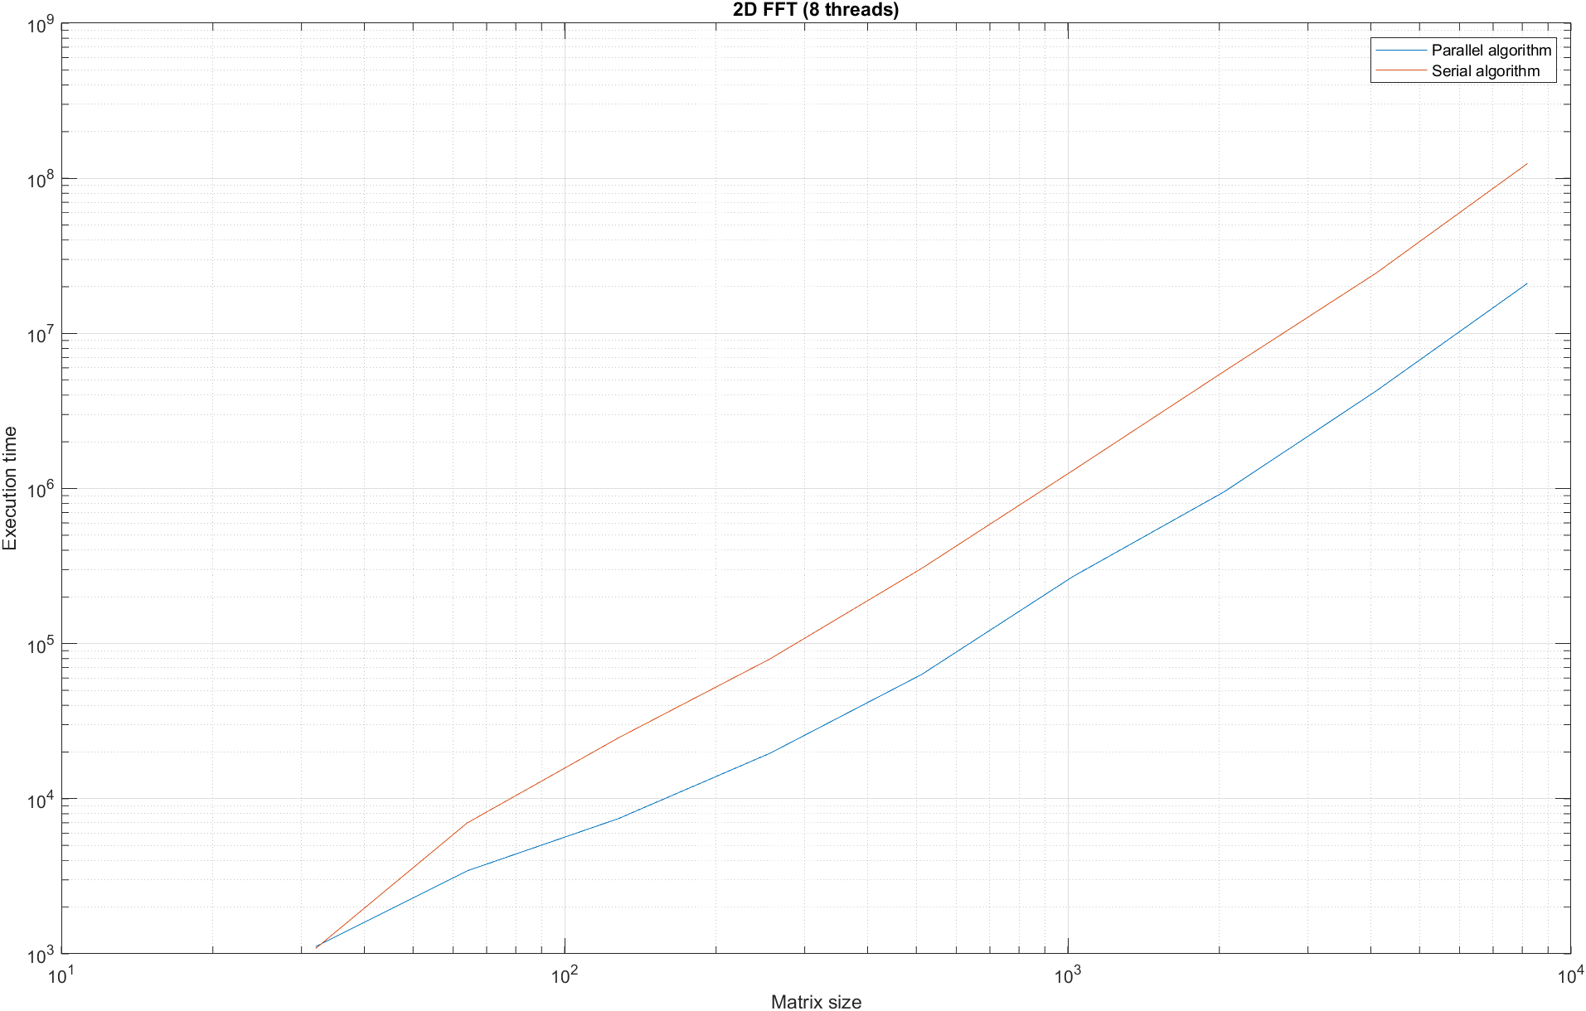
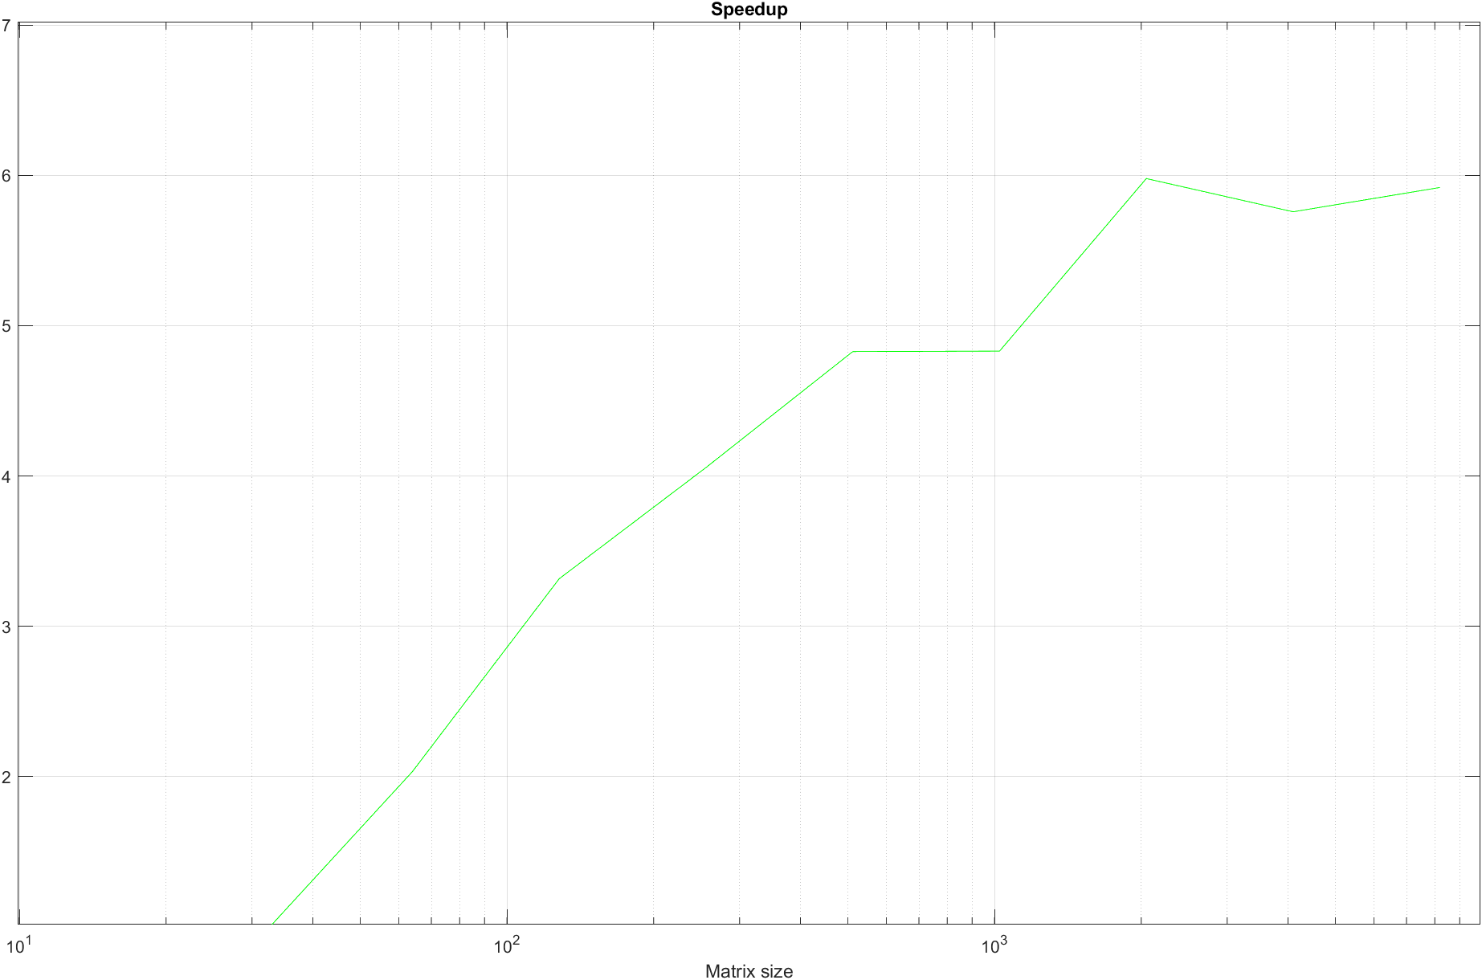
Time analysis

Slide 23
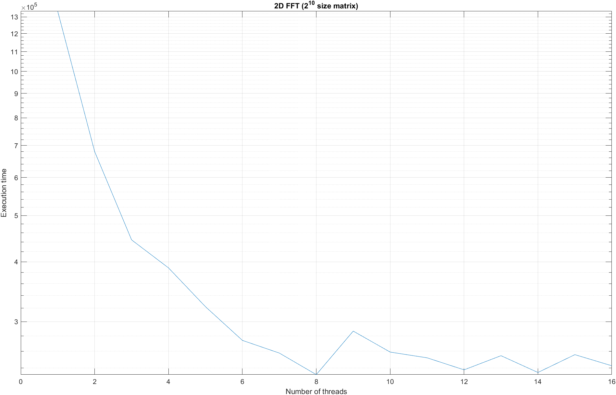
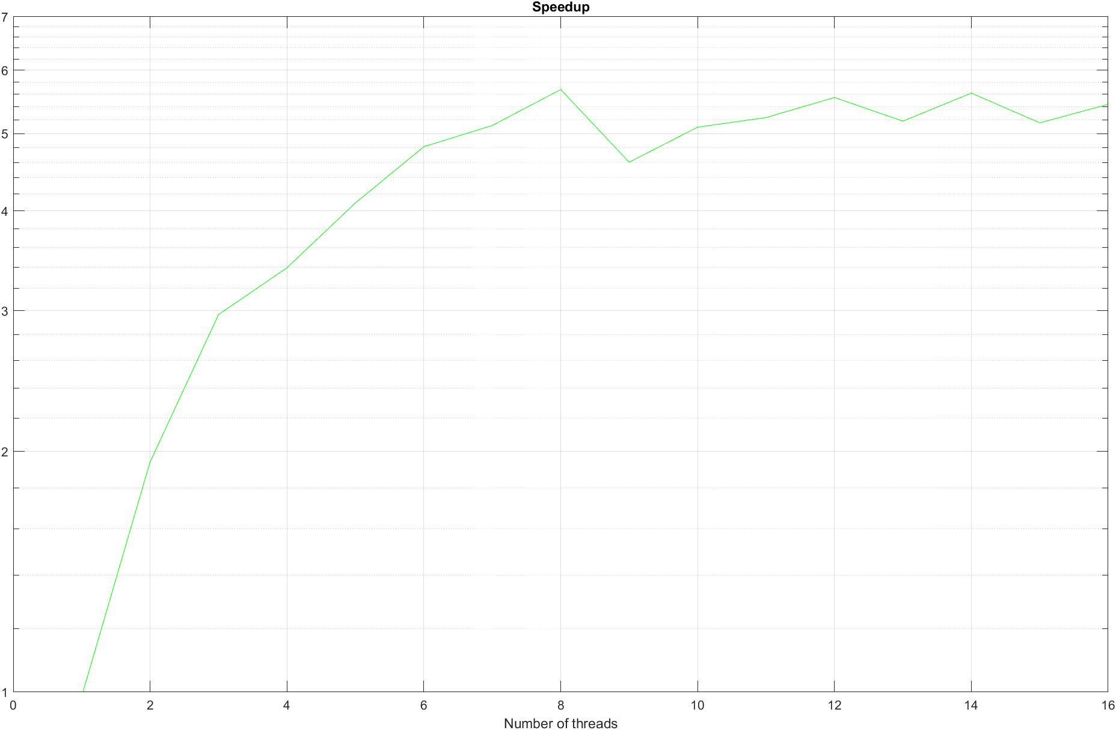

Slide 24
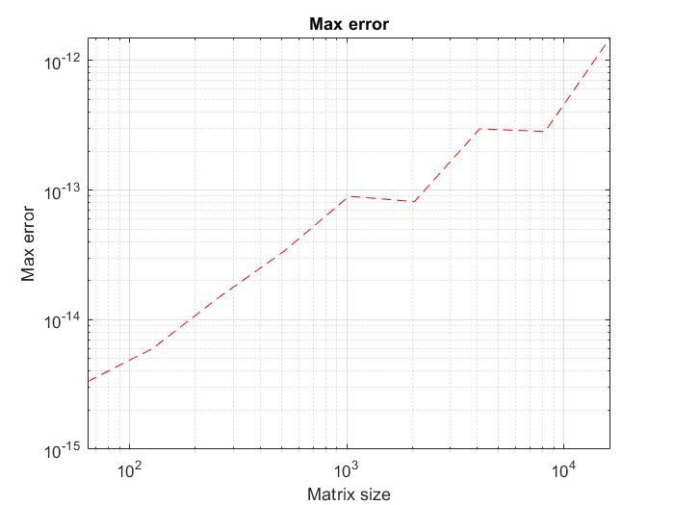
Error analysis

